Slide 1
^{DSI Capstone} ^{11/14 Weekly Update}
Nov 17, 2022

Slide 2
Agenda
1
From Last Week
2
Modeling Deep Dive: Optimization on Gurobi
3
Business Case: Initial Version
4
Next Steps

Slide 3
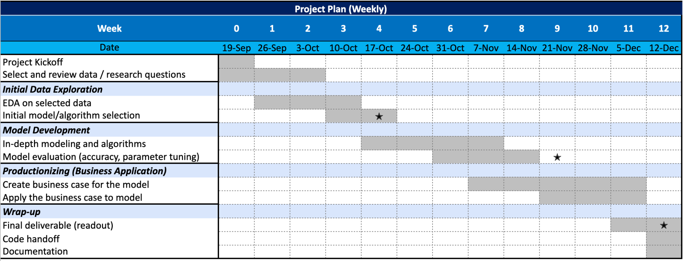
From Last Week: Timeline
1
1st progress report
2nd progress report

Slide 4
From Last Week
1
Action items:
Model comparison: consider other objective functions and compare the evaluation metrics (required by Columbia professor)
Proceed with business case
Gather enough data and work out a first/naive version of insights and solutions

Slide 5
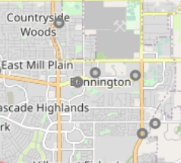
Modeling Deep Dive: Optimization Model Improvement ¹
2
Variable
Each gas station location
(output will be charger numbers in each location)
Average EV traffic coverage per charger within 1 miles based on current state (ratio²):
168
Objective function
Minimize proposed EV charger cnt in all stations
Constraints
Fixed constraints:
Driving distance to highway exit < 5 10 miles
No additional new EV stations appearing in 2.5-mile straight line radius
Constraints varied by variables:
All traffic demand satisfied:
(Proposed EV charger cnt at this location + existing EV charger cnt within 5 miles + proposed EV charger cnt within 5 miles) * ratio² >= EV traffic cnt
Proposed EV charger cnt at this location < 10 ³
1.
2. total traffic ratio = traffic count within 1 miles / # of EV stations within 1 miles for each Seattle (busy) area I-5 exits
take the average of each ratio on exits and come to the final ratio
To approximate the EV traffic, we multiply the total traffic by 1.6%
3. We can only apply this constraint to small models due to Gurobi License limitation
✕
2.5 miles
5 miles
✕
✕
10
10
10
10+10 = 20
Old model
New model

Slide 6
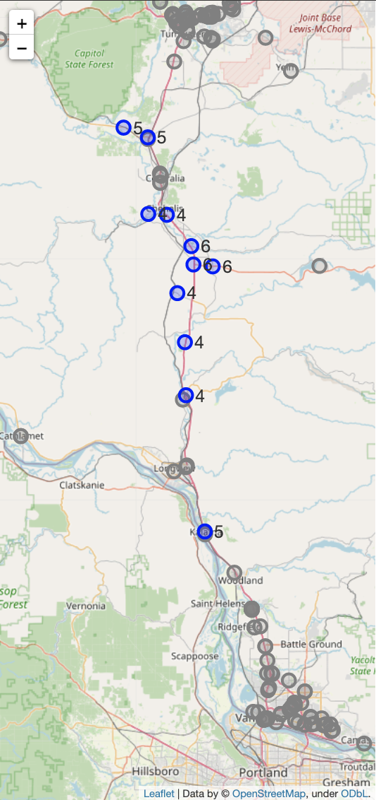
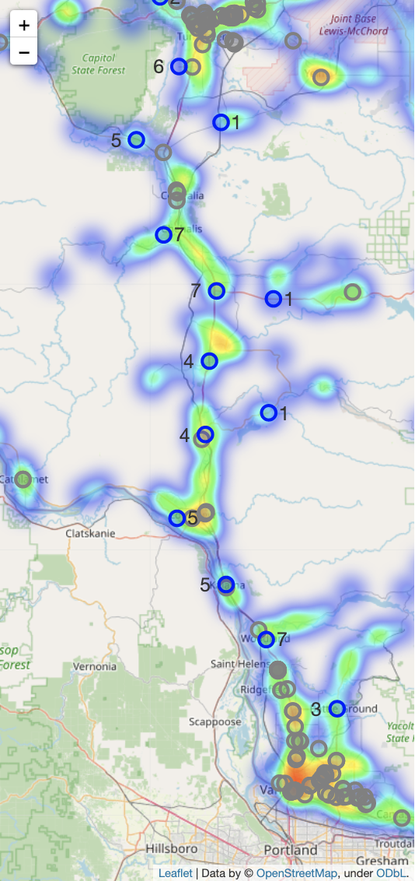
Improvement - Current Demand Scenario (2022)
2
: Existing EV charging location
: Suggested new EV charging location
Model LAST WEEK
EV% = 1.6%
Suggested 11 locations
Model THIS WEEK
EV% = 1.6%
Suggested 12 locations
Removed original problem of duplicated proposed EV charger cnt crowded together
Additional reasonable locations appeared
Model version: pandas: 1.3.5, gurobipy: 9.5.2 (detail see appendix)

Slide 7
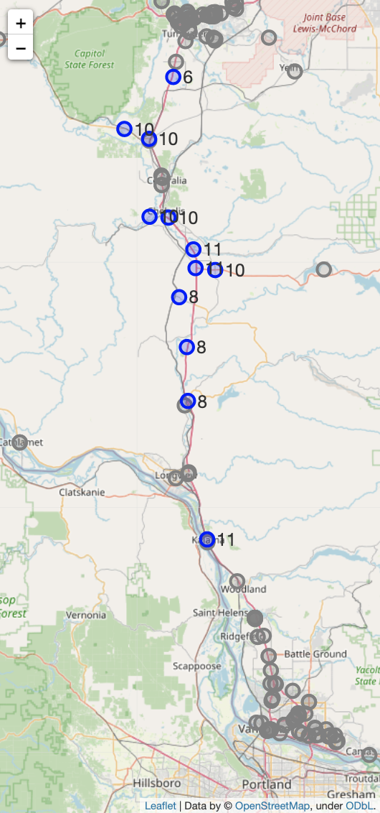
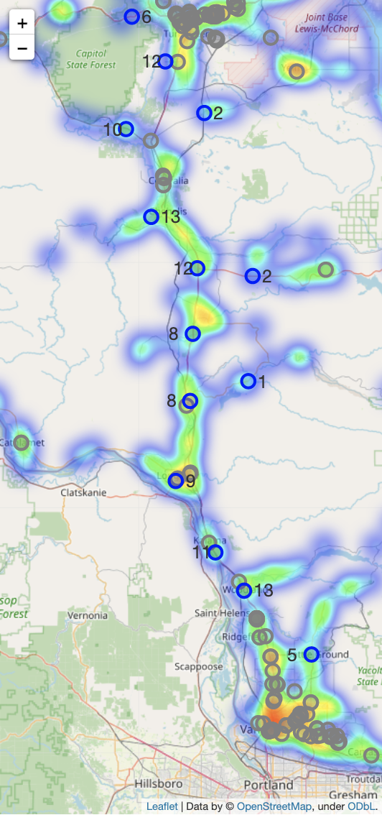
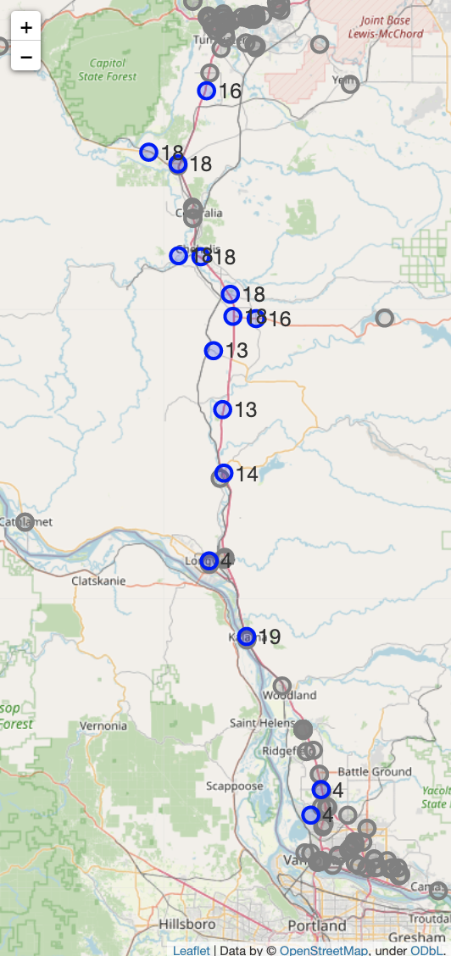
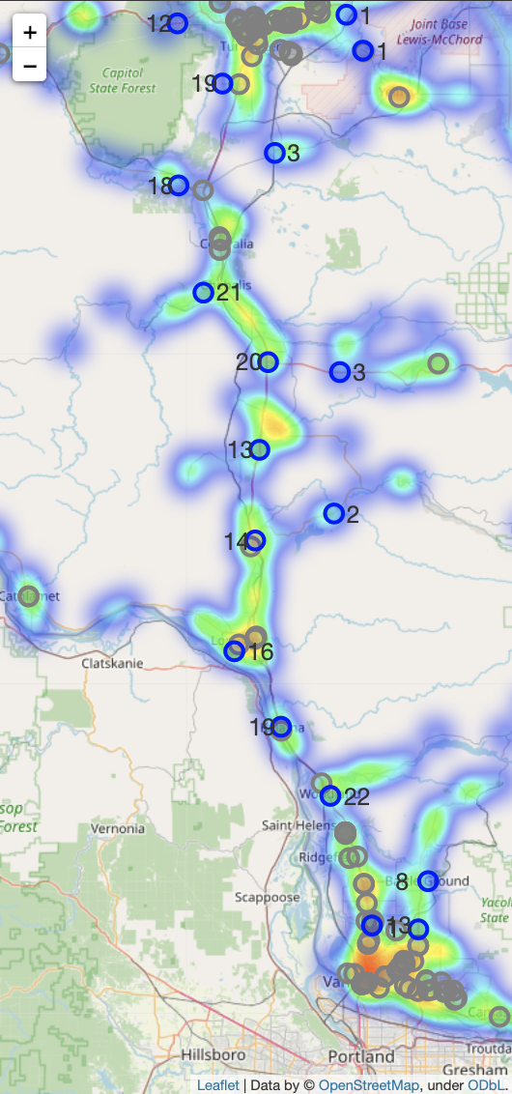
Improvement - Future Demand Scenario
2
: Existing EV charging location
: Suggested new EV charging location
2026
EV% = 3%
2030
EV% = 5%
Model LAST WEEK
Suggested 12 locations
Model THIS WEEK
Suggested 14 locations
Model LAST WEEK
Suggested 15 locations
Model THIS WEEK
Suggested 18 locations
Model version: pandas: 1.3.5, gurobipy: 9.5.2 (detail see appendix)

Slide 8
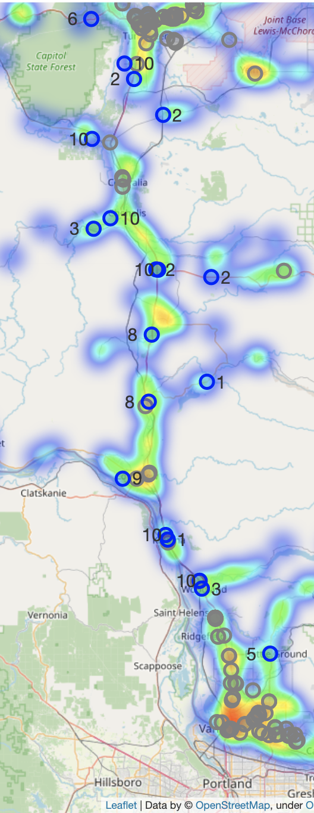
Improvement - Future Demand Scenario
2
2026
EV% = 3%
: Existing EV charging location
: Suggested new EV charging location
When we apply the same constraint on 5% demand scenario, the model is infeasible. This may due to
Lack of available candidates (e.g. need 24 chargers in one area but there are only 2 available gas station candidates)
Apply additional constraint:
Proposed EV charger cnt < 10
Model LAST WEEK
Suggested 12 locations
Model THIS WEEK
Suggested 14 locations
Model THIS WEEK
Suggested 19 locations
Model version: pandas: 1.3.5, gurobipy: 9.5.2 (detail see appendix)

Slide 9
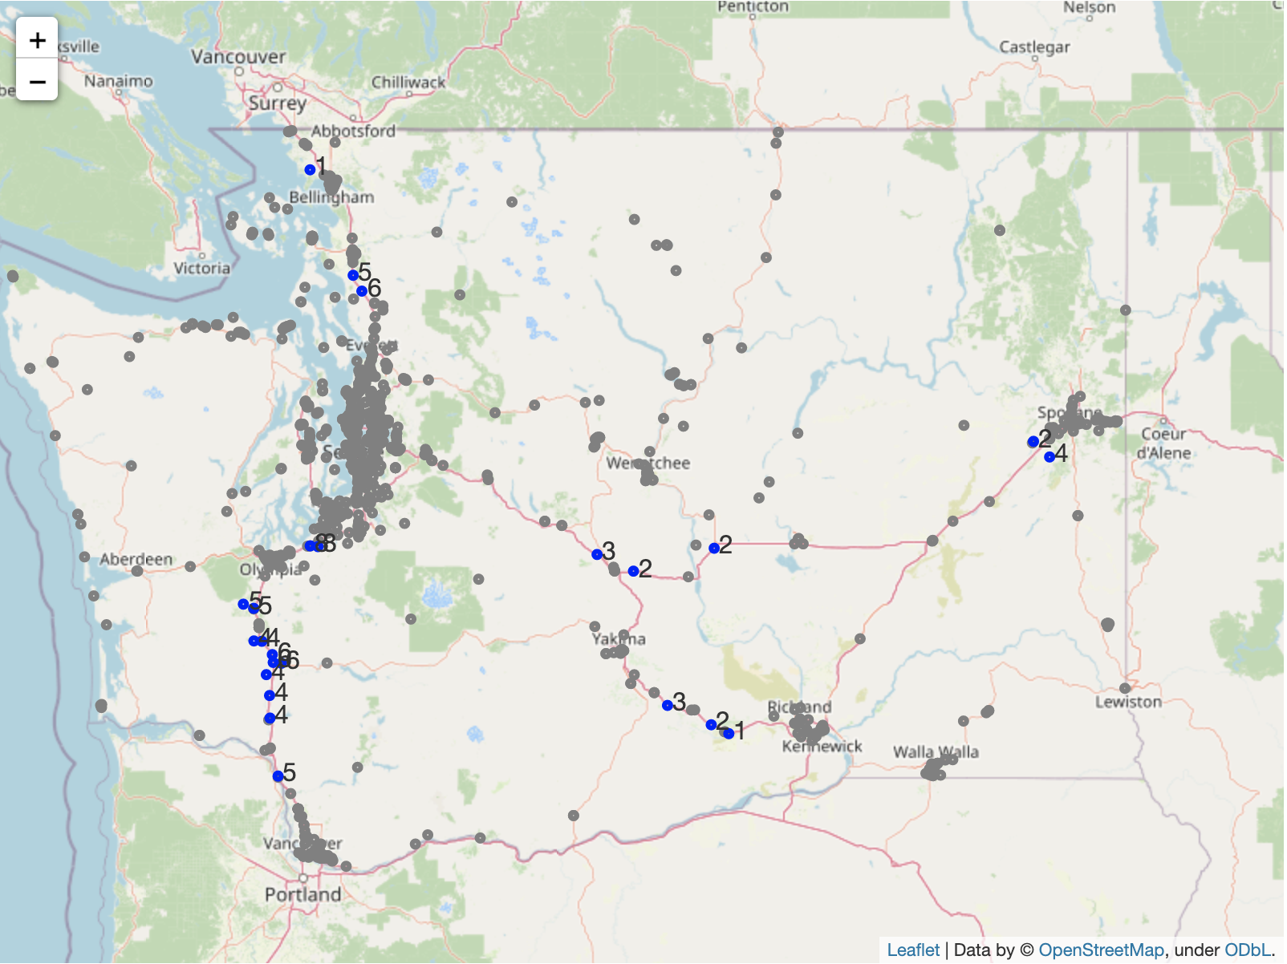
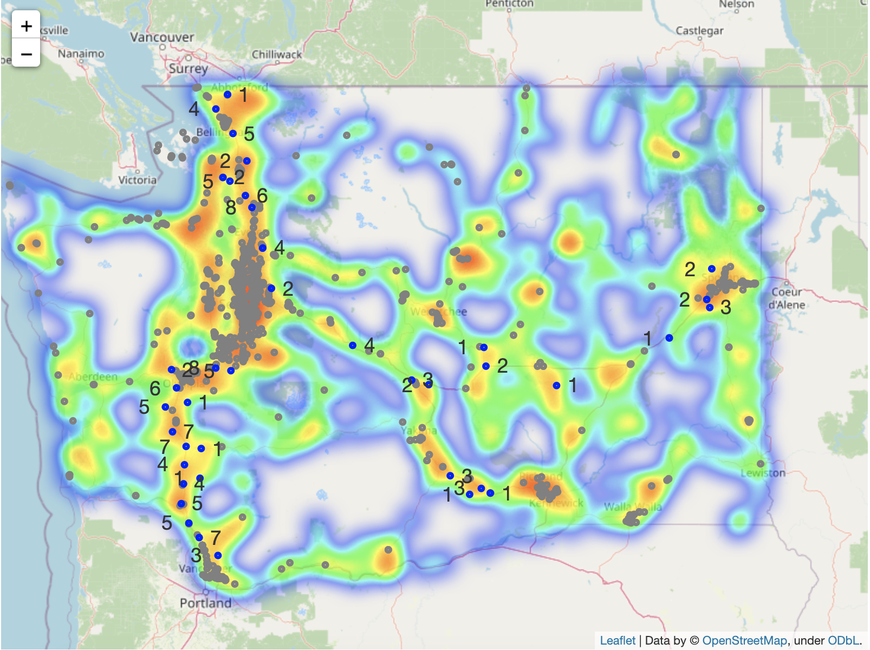
Improvement - Other Routes: Current Demand Scenario (2022)
2
: Existing EV charging location
: Suggested new EV charging location
Model LAST WEEK
EV% = 1.6%
Suggested 24 additional EV charging locations
Model THIS WEEK
EV% = 1.6%
Suggested 40 additional EV charging locations
I-5
I-90
I-82
Additional optimal locations appeared in some areas which weren’t identified previously
Model version: pandas: 1.3.5, gurobipy: 9.5.2 (detail see appendix)

Slide 10
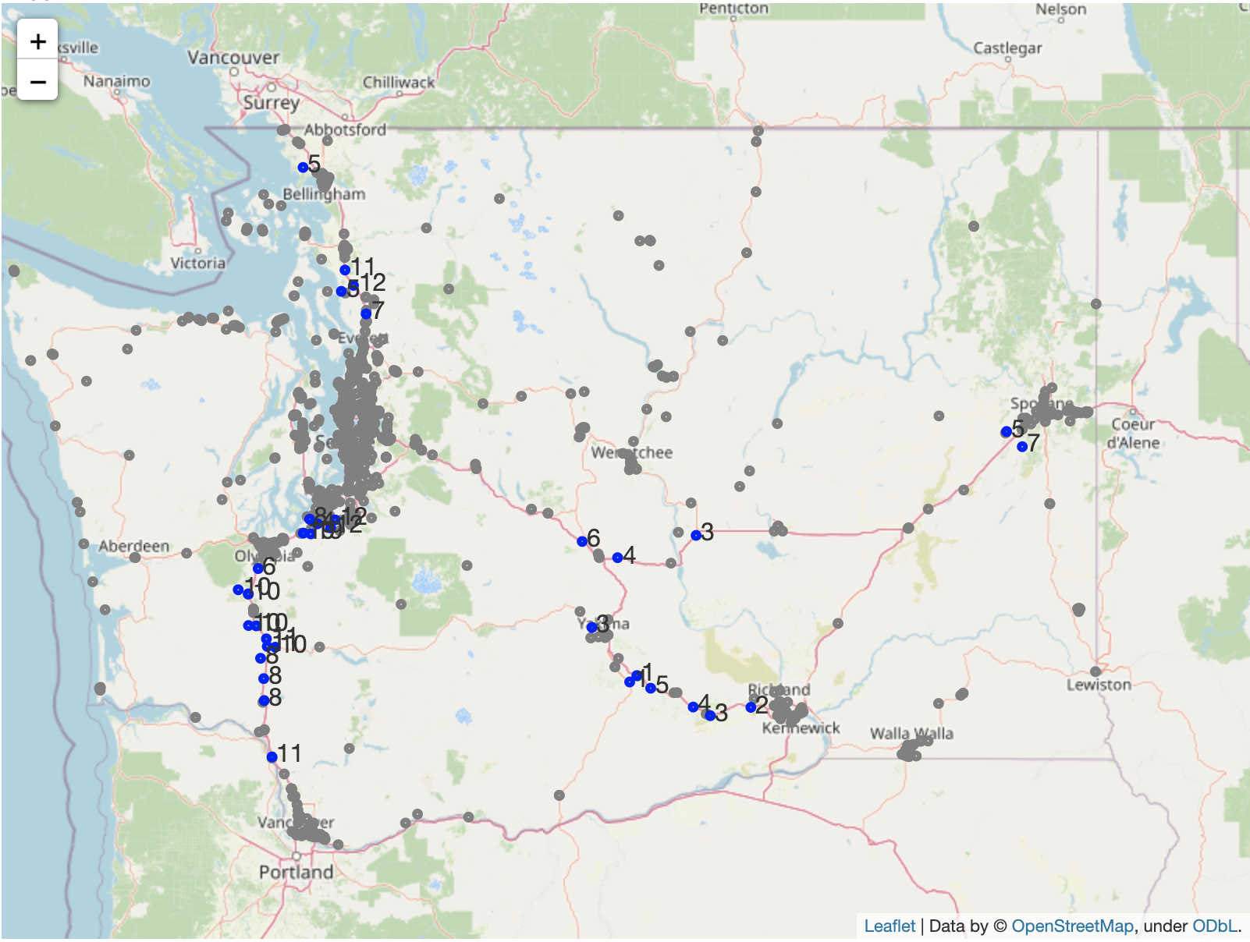
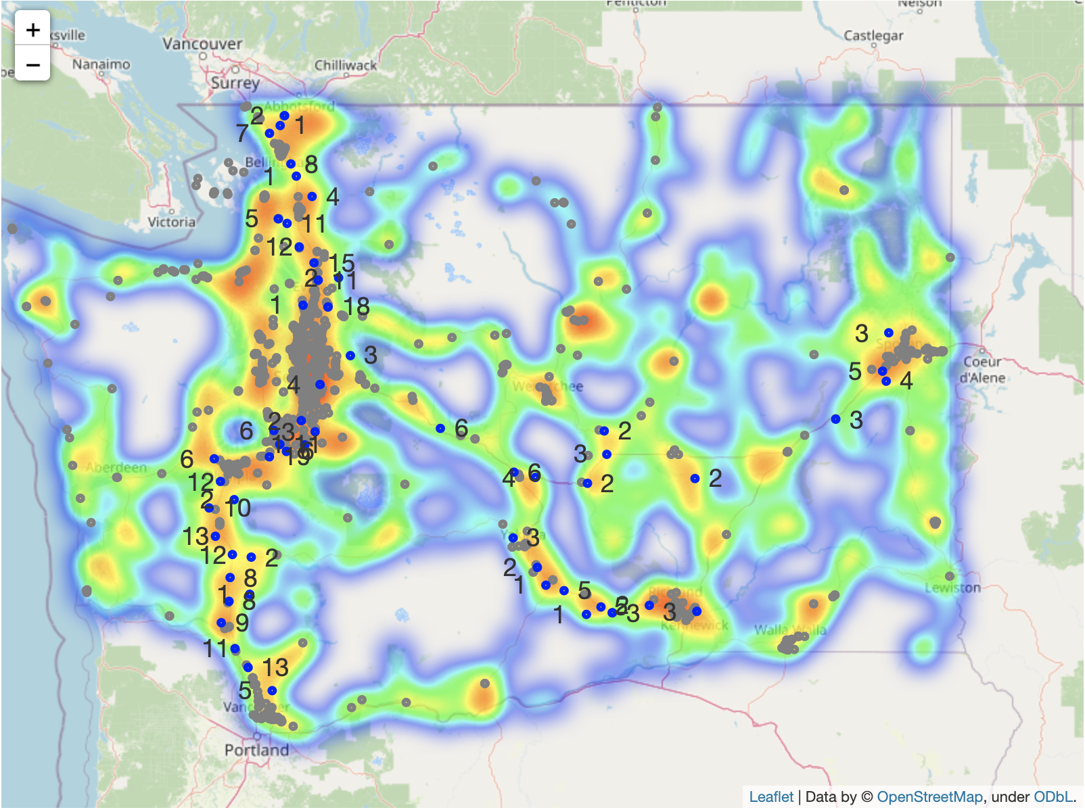
Improvement - Other Routes: Current Demand Scenario (2026)
2
: Existing EV charging location
: Suggested new EV charging location
Model LAST WEEK
EV% = 3.0%
Suggested 35 additional EV charging locations
Model THIS WEEK
EV% = 3.0%
Suggested 57 additional EV charging locations
Additional optimal locations appeared in some areas which weren’t identified previously
Model version: pandas: 1.3.5, gurobipy: 9.5.2 (detail see appendix)

Slide 11
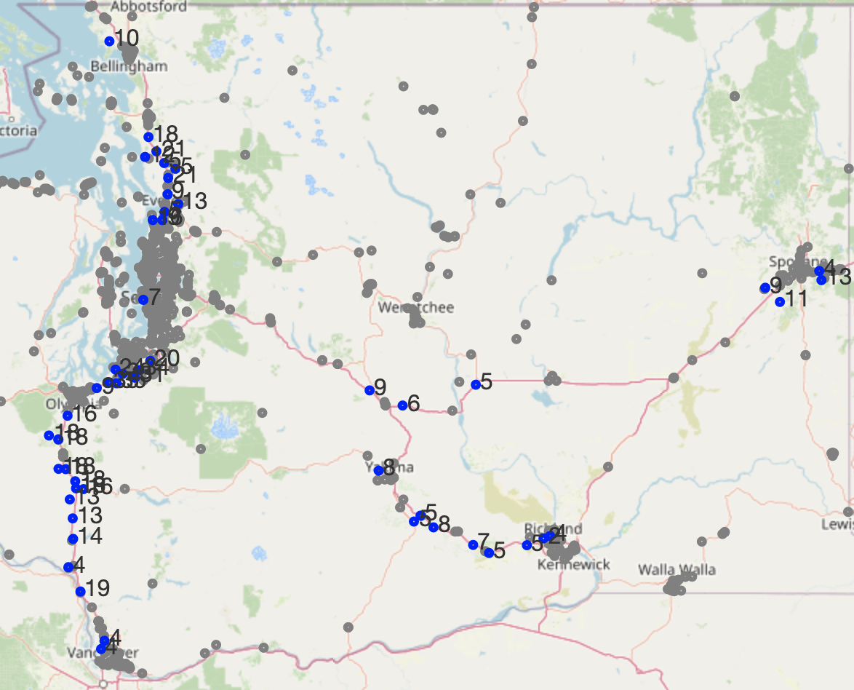
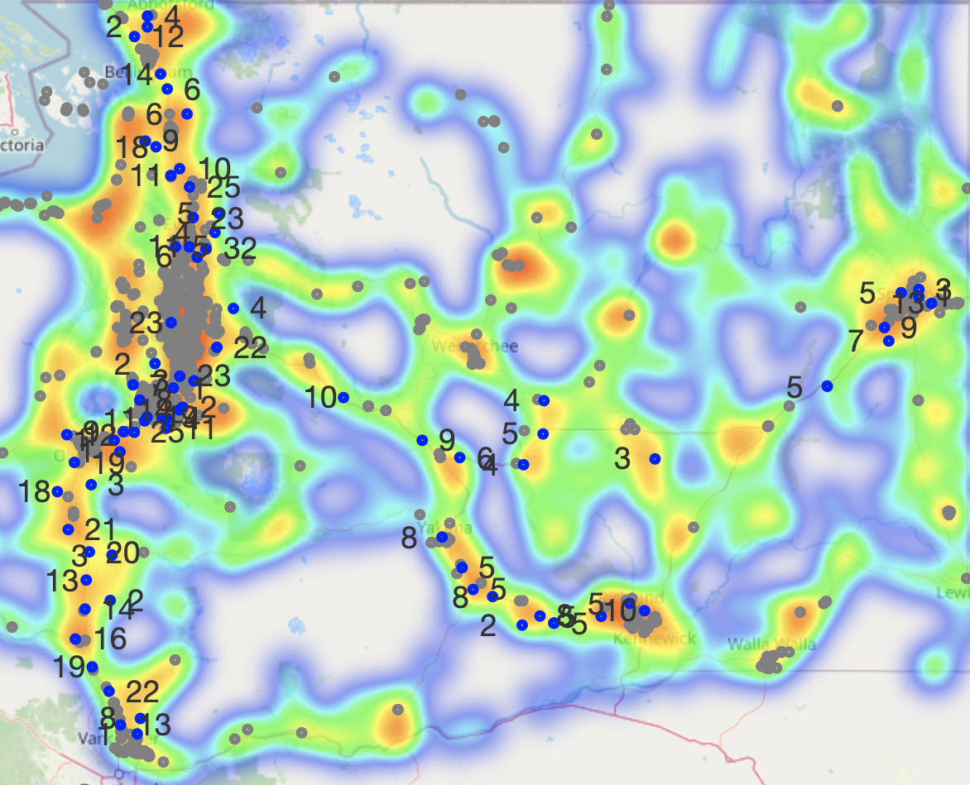
Improvement - Other Routes: Current Demand Scenario (2030)
2
: Existing EV charging location
: Suggested new EV charging location
Model LAST WEEK
EV% = 5.0%
Suggested 52 additional EV charging locations
Model THIS WEEK
EV% = 5.0%
Suggested 78 additional EV charging locations`
Additional optimal locations appeared in some areas which weren’t identified previously
Model version: pandas: 1.3.5, gurobipy: 9.5.2 (detail see appendix)

Slide 12
Modeling Deep Dive: Optimization Model Comparison
2
Variable
Each gas station location
(output will be charger numbers in each location)
Average EV traffic coverage per charger within 1 miles based on current state (ratio¹):
168
Objective function
Version 1 - Minimize proposed EV charger cnt in all stations
Version 2 - Minimize total distance to nearest exists from all stations
Constraints
Fixed constraints:
Driving distance to highway exit < 10 miles
Constraints varied by variables:
All traffic demand satisfied:
(Proposed EV charger cnt at this location + existing EV charger cnt within 5 miles + proposed EV charger cnt within 5 miles) * ratio¹ >= EV traffic cnt
Proposed EV charger cnt at this location < 10²
1. total traffic ratio = traffic count within 1 miles / # of EV stations within 1 miles for each Seattle (busy) area I-5 exits
take the average of each ratio on exits and come to the final ratio
To approximate the EV traffic, we multiply the total traffic by 1.5%
2. We can only apply this constraint to small models due to Gurobi License limitation

Slide 13
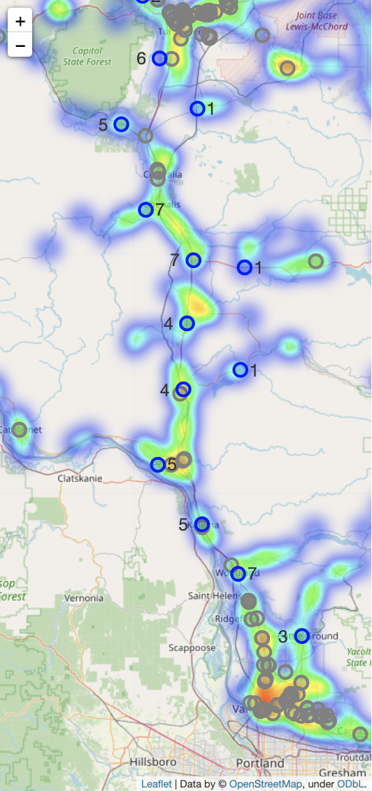
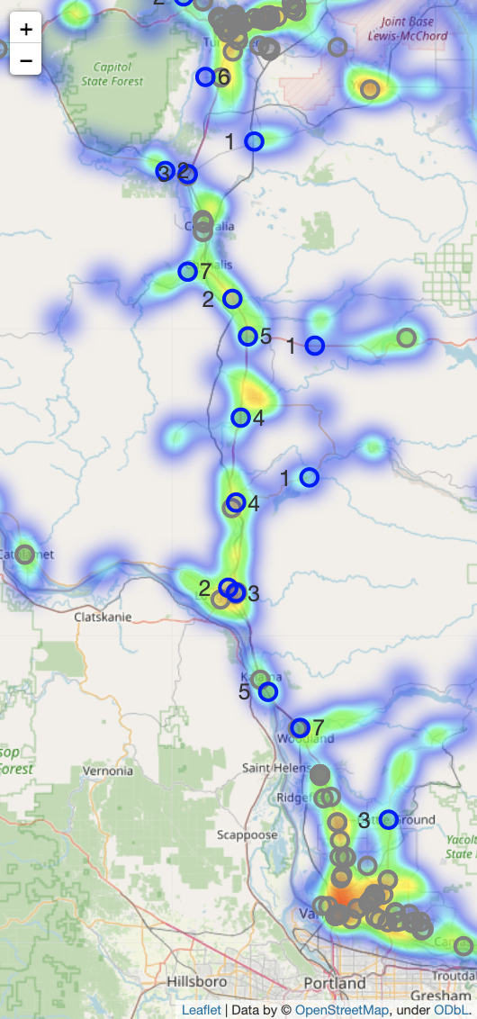
Comparison - Current Demand Scenario (2022)
2
: Existing EV charging location
: Suggested new EV charging location
Version 1:
Minimize proposed EV charger cnt
EV% = 1.6%
Suggested 13 locations
Est. cost: $916,114
Version 2:
Minimize total distance to nearest exists
EV% = 1.6%
Suggested 16 locations
Est. cost: $1,035,037
Evaluation metric - cost:
cost building stations + cost adding chargers + cost driving from exits to each station
$40,000 - cost per station
$7,000 - cost per charger
$0.2 - cost driving per mile per EV car
The only difference between the two models is that, in some area, one station is divided up into two or more stations closer to exits
Version 1 saves ~$118,000
Model version: pandas: 1.3.5, gurobipy: 9.5.2 (detail see appendix)

Slide 14

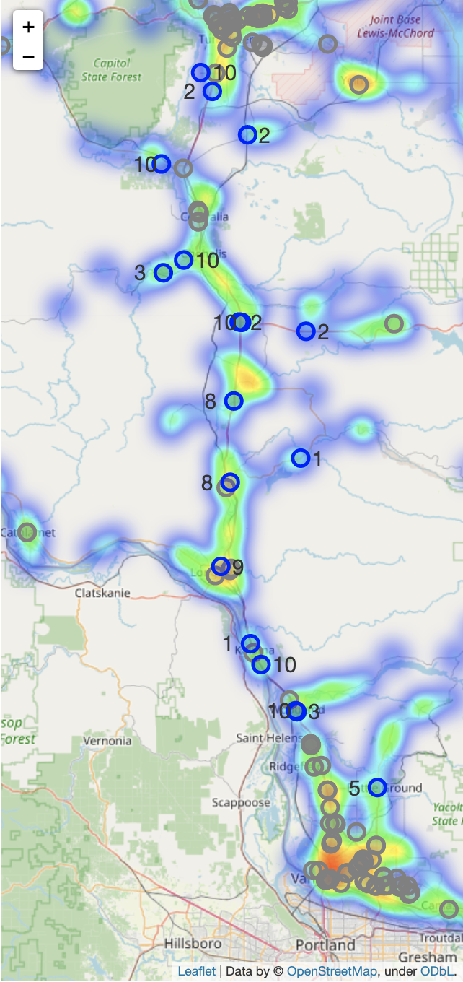

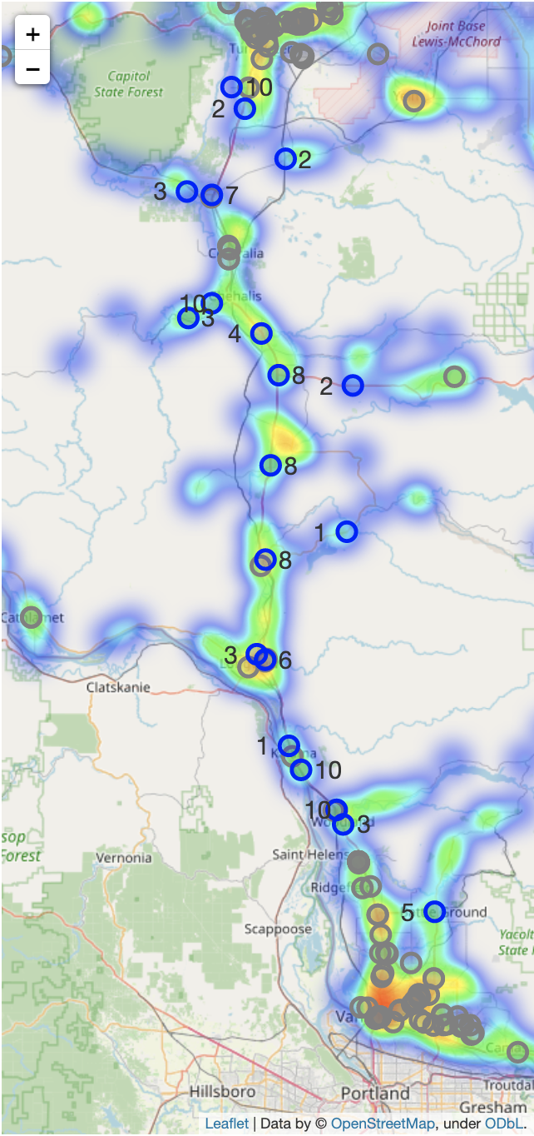
Comparison - Future Demand Scenario (2026)
2
: Existing EV charging location
: Suggested new EV charging location
Version 1:
Minimize proposed EV charger cnt
EV% = 3.0%
Version 2:
Minimize total distance to nearest exists
EV% = 3.0%
Version 1 saves ~$80,000
:
Apply “proposed EV charger cnt per location < 10” costraint
Suggested 13 locations
Est. cost: $1,268,330
Suggested 18 locations
Est. cost: $1,470,894
Suggested 16 locations
Est. cost: $1,387,694
Suggested 20 locations
Est. cost: $1,550,788
Model version: pandas: 1.3.5, gurobipy: 9.5.2 (detail see appendix)

Slide 15

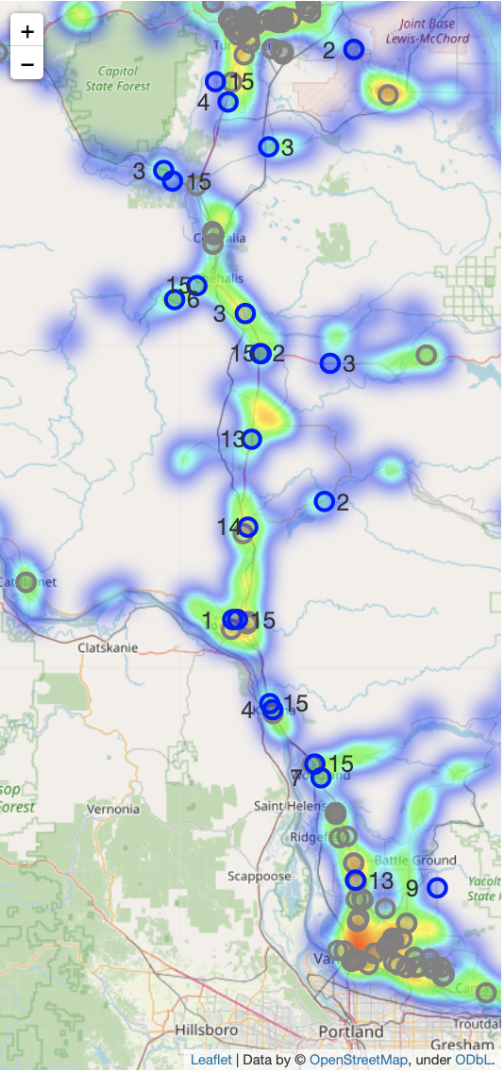
Comparison - Future Demand Scenario (2030)
2
: Existing EV charging location
: Suggested new EV charging location
Version 1:
Minimize proposed EV charger cnt
EV% = 5.0%
Suggested 23 locations
Est. cost: $2,382,564
Version 2:
Minimize total distance to nearest exists
EV% = 5.0%
Suggested 24 locations
Est. cost: $2,366,048
Version 1 saves ~ $16,500
As EV traffic percentage increases, the cost difference between two versions is getting smaller, meaning version 2 works better than version 1 when EV gets more dominant in market.
Model version: pandas: 1.3.5, gurobipy: 9.5.2 (detail see appendix)

Slide 16
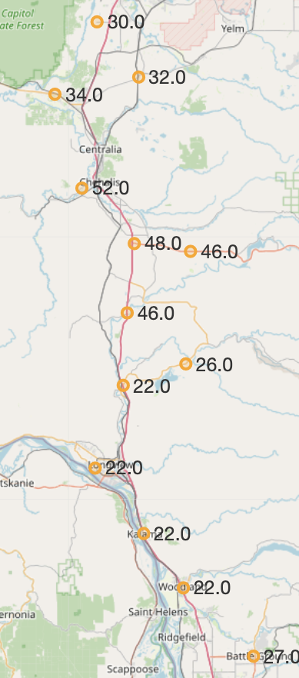
Business Case - produce a score on optimized locations
3
Idea
Create a linear combination on selected features
Features
# of attraction/entertainments within 1 mile driving distance
Crime rate (includes violent crime, murder, rape, robbery, assault, property crime, burglary, larceny theft, motor vehicle theft, arson)
Take total and calculate rate based on population
Natural risk score
Weights
All same (1) on three features
Process
Use min-max scaler on each three features to make the number from 0 to 1 on all data
Add each features together:
1*# of attractions in 1 miles + 1*total crime rate + 1*natural risk score
Use min-max scaler on the score to make them from 0 to 1
Query the score on optimized locations
Improvement
Total crime -> different weights on different types of crime
e.g, put more weight on motor vehicle theft comparing to arson
All same weight for three features -> different weights on three features
Add machine learning methods for comparison: based on current established patterns, what will be the score for each location
Notes:
Mutually exclusive here: no consideration for distance from exists and traffic since used them in optimization

Slide 17
Next Steps
4
Action items:
Finish 2nd report (required by Columbia DSI Capstone project course)
Improve evaluation metric on models
Gather more data on unit cost on station/charger/driving per mile
Try other metrics
Modify business case: adjust weights and try other models

Slide 18
Appendix

Slide 19
Python Libraries Used
pandas: 1.3.5
numpy: 1.21.6
gurobipy: 9.5.2
geopy: 1.17.0
folium: 0.12.1.post1
requests: 2.23.0
json: 2.0.9

